Slide 1
Nourriture - Connect People with Ingredients
fastDev@AWS
Beijing Jiao Tong University

Slide 2
Overview of Cloud Computing
Beijing Jiao Tong University

Slide 3
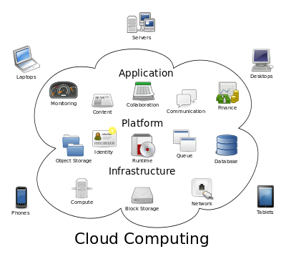
What & Why Cloud Computing
What:
It is computing in which large groups of remote servers are networked to allow the centralized data storage, and online access to computer services or resources.
Why:
The cloud aims to cut costs, and help the users focus on their core business instead of being impeded by IT obstacles.
Beijing Jiao Tong University

Slide 4
Characteristics
National Institute of Standards and Technology
On-demand self-service
A consumer can unilaterally provision computing capabilities, such as server time and network storage, as needed automatically without requiring human interaction with each service provider.
Broad network access.
Capabilities are available over the network and accessed through standard mechanisms that promote use by heterogeneous thin or thick client platforms (e.g., mobile phones, tablets, laptops, and workstations).
Resource pooling.
The provider's computing resources are pooled to serve multiple consumers using a multi-tenant model, with different physical and virtual resources dynamically assigned and reassigned according to consumer demand.
Rapid elasticity.
Capabilities can be elastically provisioned and released, in some cases automatically, to scale rapidly outward and inward commensurate with demand. To the consumer, the capabilities available for provisioning often appear unlimited and can be appropriated in any quantity at any time.
Measured service.
Cloud systems automatically control and optimize resource use by leveraging a metering capability at some level of abstraction appropriate to the type of service (e.g., storage, processing, bandwidth, and active user accounts). This is transparent for both the provider and consumer of the utilized service.
Beijing Jiao Tong University
Notes:
Heterogeneous：异构
Multi-tenant：多租户

Slide 5
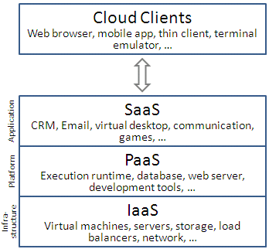
Service Models
Infrastructure as a service (IaaS)
e.g. Google Compute Engine
Physical or (more often) virtual machines and other resources, such as a virtual-machine disk image library, raw block storage, and file or object storage, firewalls, load balancers, IP addresses, virtual local area networks (VLANs), …
Platform as a service (PaaS)
e.g. Google App Engine
Deliver a computing platform, typically including operating system, programming language execution environment, database, and web server.
Software as a service (SaaS)
e.g. Google Apps
Referred to as "on-demand software“. cloud providers install and operate application software in the cloud and cloud users access the software from cloud clients.
Beijing Jiao Tong University

Slide 6
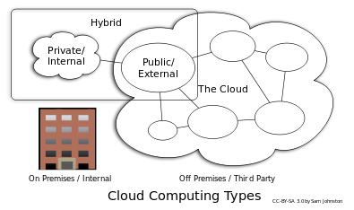
Deployment Models
Private cloud
Private cloud is cloud infrastructure operated solely for a single organization, whether managed internally or by a third-party, and hosted either internally or externally.
Public cloud
When the services are rendered over a network that is open for public use.
Hybrid cloud
Hybrid cloud is a composition of two or more clouds (private, community or public) that remain distinct entities but are bound together,
Beijing Jiao Tong University

Slide 7
Overview of AWS Cloud Design Pattern
Beijing Jiao Tong University

Slide 8
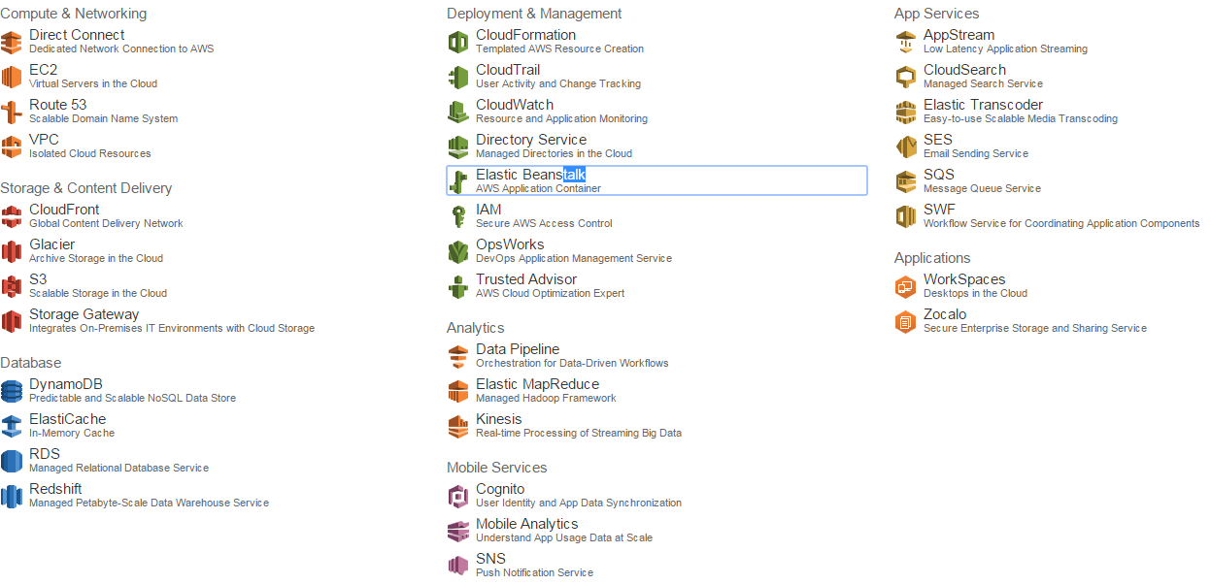
What AWS
Amazon Web Services is a collection of remote computing services (also called web services) that together make up a cloud computing platform, offered over the Internet by Amazon.com.
Beijing Jiao Tong University

Slide 9
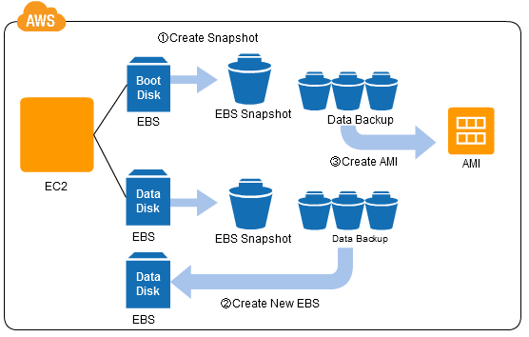
Basic Patterns @ Snapshot (Backup)
Problems to Be Solved
It is important that data is safe. This means that it is important for us to back up the data.
Implementation
The virtual disk Elastic Block Store (EBS), which is the virtual storage in AWS, has a snapshot function. When you take a snapshot, it is stored in the Amazon Simple Storage Service (S3) object storage, which is designed to have 99.999999999% durability. It can backup not just of user data, but of each individual operating system as well.
Beijing Jiao Tong University

Slide 10
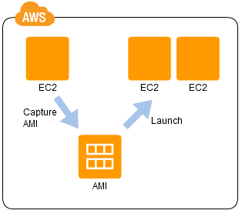
Basic Patterns @ Stamp (Clone)
Problems to Be Solved
Setting up the OS and the applications required for a virtual server takes just as much work, time, and expense as for a physical server.
Implementation
Create an Amazon Machine Image (AMI) from an Elastic Block Store (EBS) that includes the boot region of the operating system, you will be able to launch an EC2 (Elastic Compute Cloud) instance from the AMI, making it possible for you to produce a large numbers of EC2 instances with identical settings.
Beijing Jiao Tong University

Slide 11
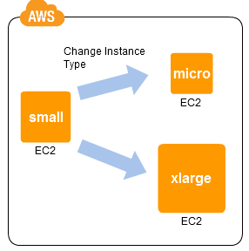
Basic Patterns @ Scale Up (Vertical Scale)
Problems to Be Solved
It is difficult to estimate, during the system development phase, the server resources that will be required after deployment, e.g. big one or small one?
Implementation
Monitor the resource utilization using vmstat or a resource monitor, CloudWatch, or the like, and if the specification is inadequate (or excessive), stop the EC2 instance, and then restart after adjusting the instance type using the Change Instance Type menu of the AWS Management Console.
Beijing Jiao Tong University

Slide 12
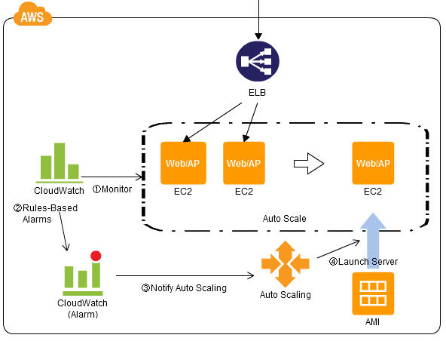
Basic Patterns @ Scale Out (Horizontal Scale)
Problems to Be Solved
Scale up has problems. Typically, the higher the specification in a high-specification server, the higher the unit processing cost.
Implementation
Set up multiple EC2 instances in parallel under the control of ELB. And define the conditions to trigger an increase or decrease in the number of EC2 instances.
Beijing Jiao Tong University

Slide 13
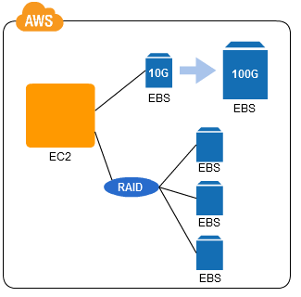
Basic Patterns @ Ondemand Disk (Disk Capacity)
Problems to Be Solved
It is difficult to forecast in advance the disk capacity that will be used by the system, and this problem is applicable to the case that disk striping capacity
Implementation
Take a snapshot of the EBS and create a new EBS based on that snapshot, and then specify a volume of a larger size than the original volume, and then attach the new EBS to an EC2 instance. When striping, attach multiple EBS volumes behind a RAID configuration.
Beijing Jiao Tong University
Notes:
RAID stands for redundant array of independent disks

Slide 14
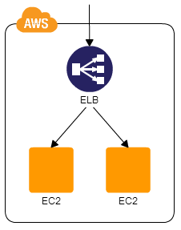
High Availability @ Multi-Server (EC2s)
Problems to Be Solved
Improve availability of the server by using multiple physical servers to provide redundancy
Implementation
Apply the Stamp Pattern, to launch multiple EC2 instances, and then launch ELB and bind the multiple EC2 instances.
Beijing Jiao Tong University

Slide 15
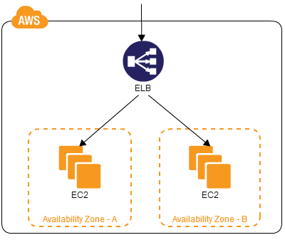
High Availability @ Multi-Datacenter (AZs)
Problems to Be Solved
While you can apply the Multi-Server Pattern to improve availability when thinking about a server failure, the Multi-Server Pattern cannot handle a case where one envisions a data center-level failure
Implementation
AWS has multiple data centers, known as Availability Zones (AZ), in different regions. Select the AZ to use and specify the AZ for locating each EC2 instance.
Beijing Jiao Tong University

Slide 16
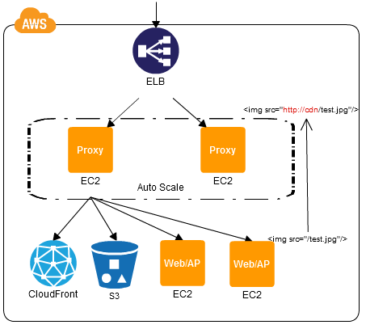
Processing Content @ Rewrite Proxy (Routing)
Problems to Be Solved
Handling load where static content is located on Internet storage or a content delivery service by change the access destinations without modifying the existing system
Implementation
Locate a proxy server (EC2) able to overwrite the content between ELB and S3, and add to the proxy server rules for overwriting URLs within the content
Beijing Jiao Tong University

Slide 17
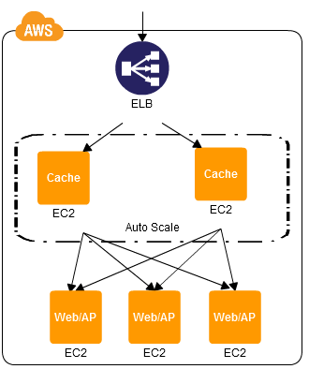
Processing Content @ Cache Proxy (Cache)
Problems to Be Solved
Use multiple web/AP servers as a way to handle high loads, it multiplies the expense (bills)
Implementation
Increase the performance of a web system is to cache your content. Place the cache server in front of the web/AP server, and set up the server to host the original data, the cache expiration, and the like.
Beijing Jiao Tong University

Slide 18
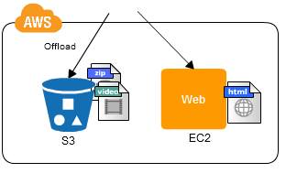
Processing Content @ Web Storage (Static Content)
Problems to Be Solved
Distribute the load through multiple web servers to reduce the load on the network– but this involves locating the large files on multiple servers, which is a problem in terms of cost. Implementation
Create a "bucket" on the S3 Internet storage, and upload the static content (image/video/compressed files, or the like) to be published.
Beijing Jiao Tong University

Slide 19
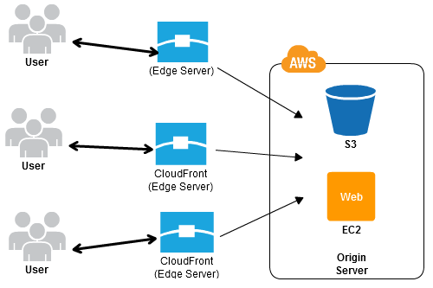
Processing Content @ Cache Distribution (CloudFront)
Problems to Be Solved
A communication delay of at least 200 ms when accessing a server on the East Coast of the United States from Japan, when users are accessing content on the Internet from an increasingly broad range of locations
Implementation
Cache data for content that is delivered from a content delivery origin is located at locations that are provided in various regions throughout the world by setting up CloudFront to use a master server.
Beijing Jiao Tong University

Slide 20
More Patterns
Get More about Cloud Design Pattern
http://en.clouddesignpattern.org/index.php/Main_Page
Beijing Jiao Tong University
Notes:
RAID stands for redundant array of independent disks

Slide 21
Get Started with AWS EC2
Beijing Jiao Tong University

Slide 22
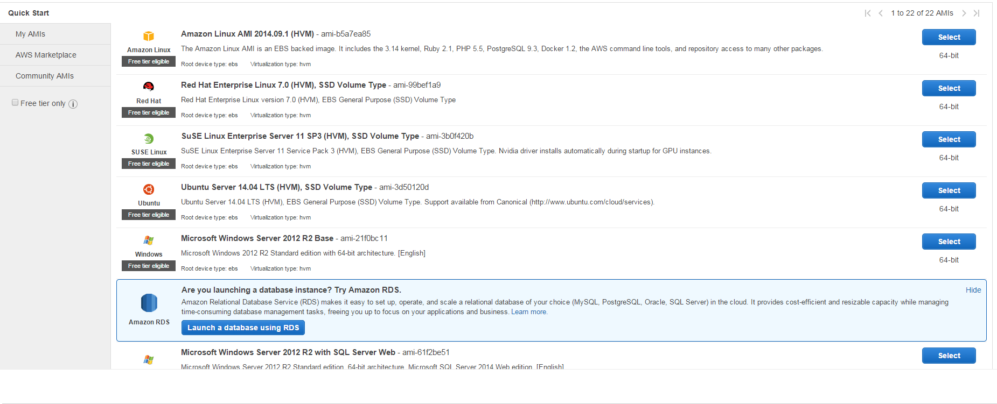
Step 1: Choose an Amazon Machine Image (AMI)
An AMI is a template that contains the software configuration (operating system, application server, and applications) required to launch your instance
Beijing Jiao Tong University

Slide 23
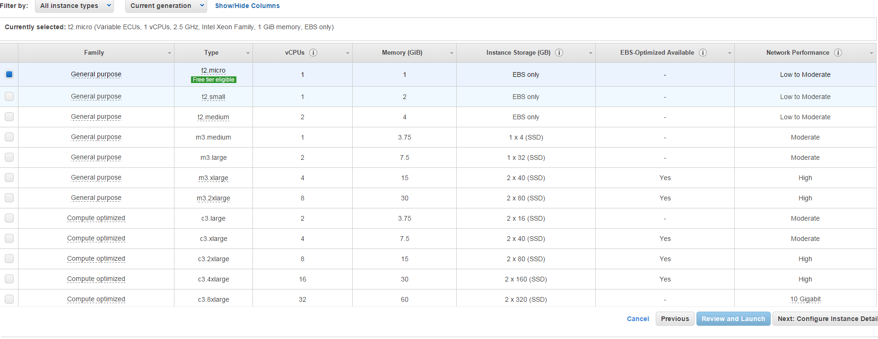
Step 2: Choose an Instance Type
Amazon EC2 provides a wide selection of instance types optimized to fit different use cases. Instances are virtual servers that can run applications.
Beijing Jiao Tong University

Slide 24
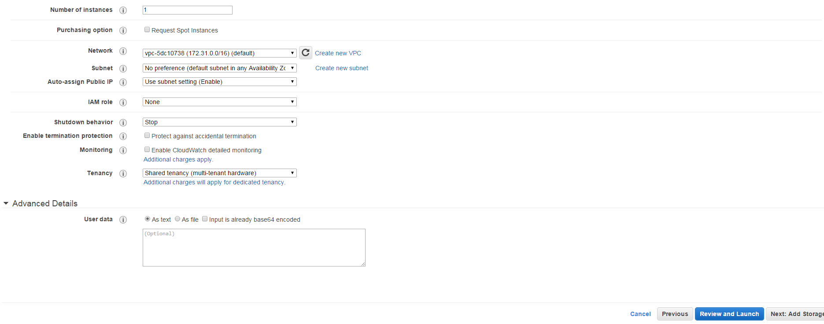
Step 3: Configure Instance Details
Launch multiple instances from the same AMI, request Spot Instances to take advantage of the lower pricing, assign an access management role to the instance, and more.
Beijing Jiao Tong University

Slide 25
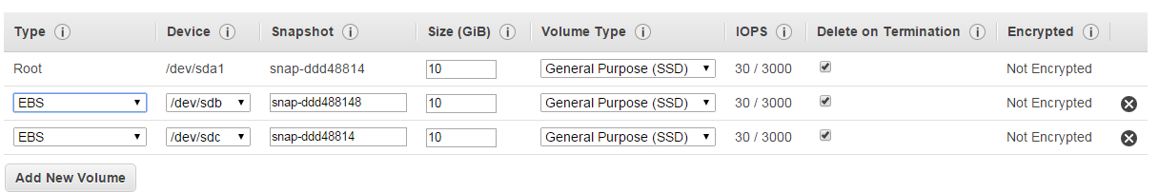
Step 4: Add Storage
Attach additional EBS volumes and instance store volumes to your instance, or edit the settings of the root volume
Beijing Jiao Tong University

Slide 26
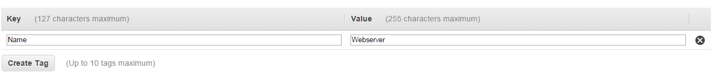
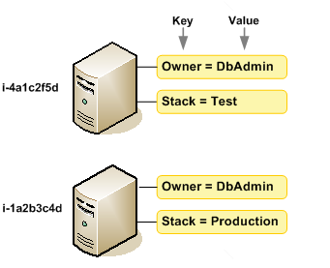
Step 5: Tag Instance
To help you manage your instances, images, and other Amazon EC2 resources, you can assign your own metadata to each resource in the form of tags by key-value pair
Beijing Jiao Tong University

Slide 27
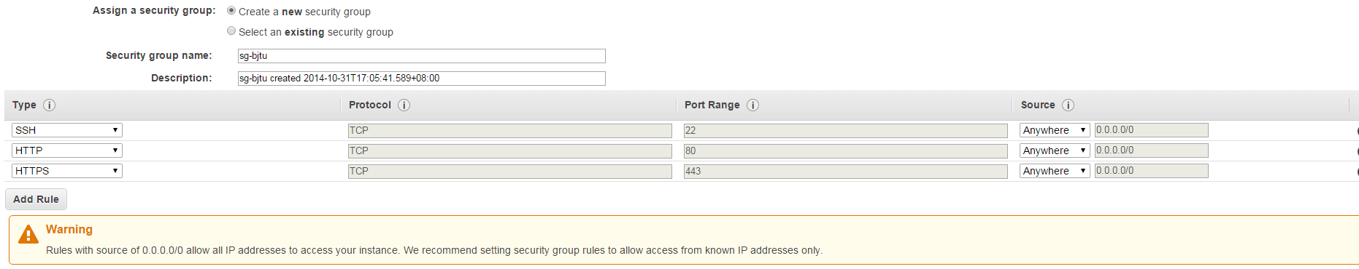
Step 6: Configure Security Group
Set up a web server and allow Internet traffic to reach your instance. A security group is a set of firewall rules that control the traffic for your instance.
Beijing Jiao Tong University

Slide 28
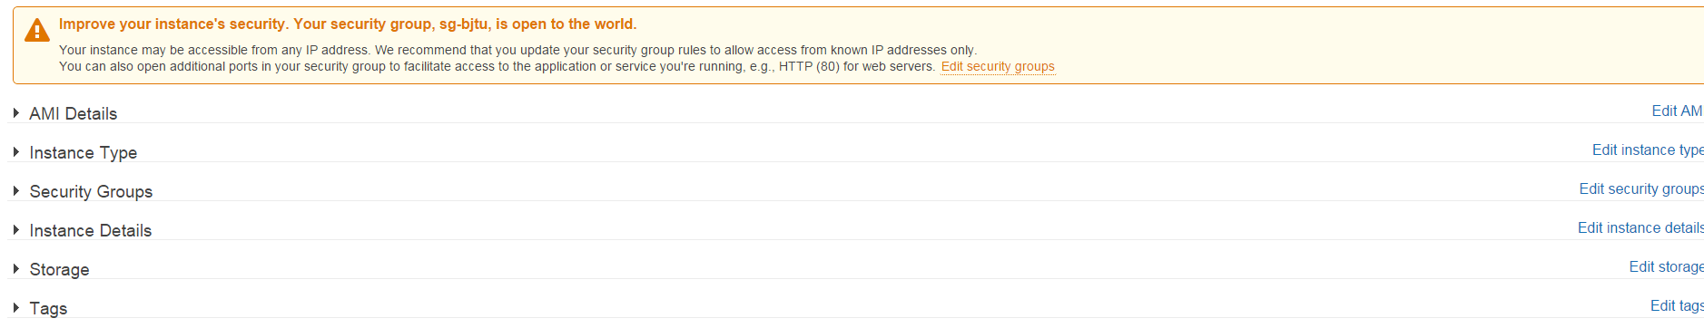
Step 7: Review Instance Launch
Review instance launch details. Click Launch to assign a key pair to your instance and complete the launch process.
Beijing Jiao Tong University

Slide 29
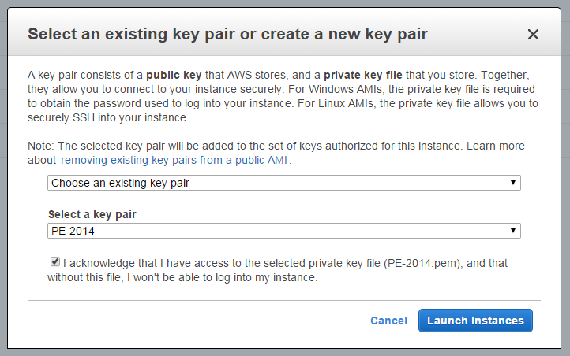
Step 8: Launch Instance
A key pair consists of a public key that AWS stores, and a private key file that you store. Together, they allow you to connect to your instance securely. For Linux AMIs, the private key file allows you to securely SSH into the instance.
Beijing Jiao Tong University

Slide 30
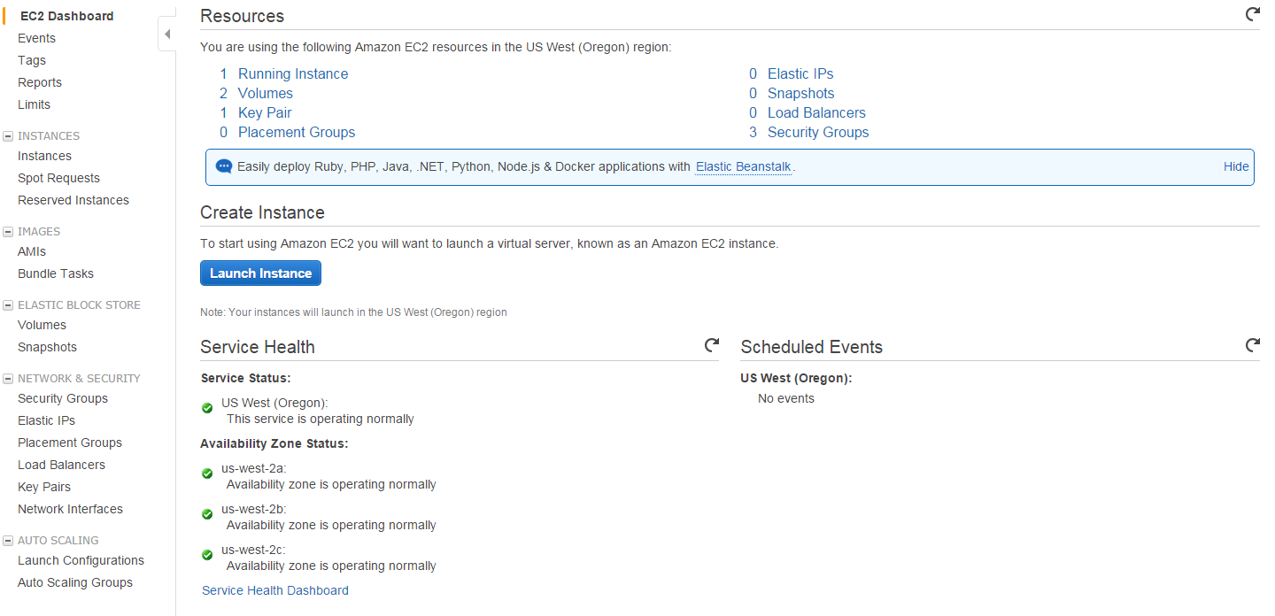
EC2 Dashboard
https://us-west-2.console.aws.amazon.com/ec2/v2/home?region=us-west-2#
Beijing Jiao Tong University

Slide 31
Reach AWS
By Management Console
http://aws.amazon.com/console/
By CLI
http://docs.aws.amazon.com/cli/latest/userguide/cli-chap-welcome.html
By Programmable API (Request, Response)
http://docs.aws.amazon.com/AWSEC2/latest/APIReference/Welcome.html
By Client library, such as for Node.js
https://github.com/livelycode/aws-lib
Beijing Jiao Tong University

Slide 32
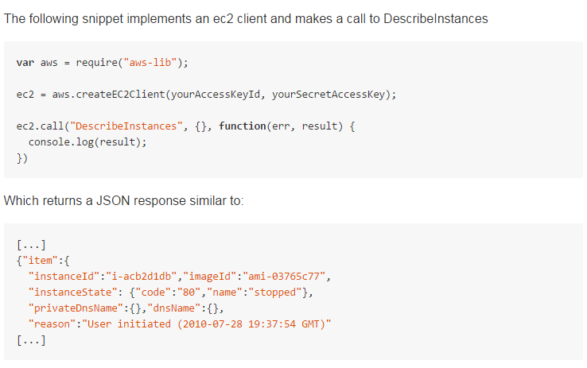
AWS Client Library
aws-lib: https://github.com/livelycode/aws-lib
Beijing Jiao Tong University

Slide 33
Reference
http://stackoverflow.com/questions/9093741/manual-deployment-vs-amazon-elastic-beanstalk
http://stackoverflow.com/questions/16820336/what-is-saas-paas-and-iaas-with-examples
http://en.wikipedia.org/wiki/Cloud_computing
http://en.clouddesignpattern.org/index.php/Main_Page
Beijing Jiao Tong University

